Slide 1
3D Point Detection

Slide 2
Introduction

Slide 3
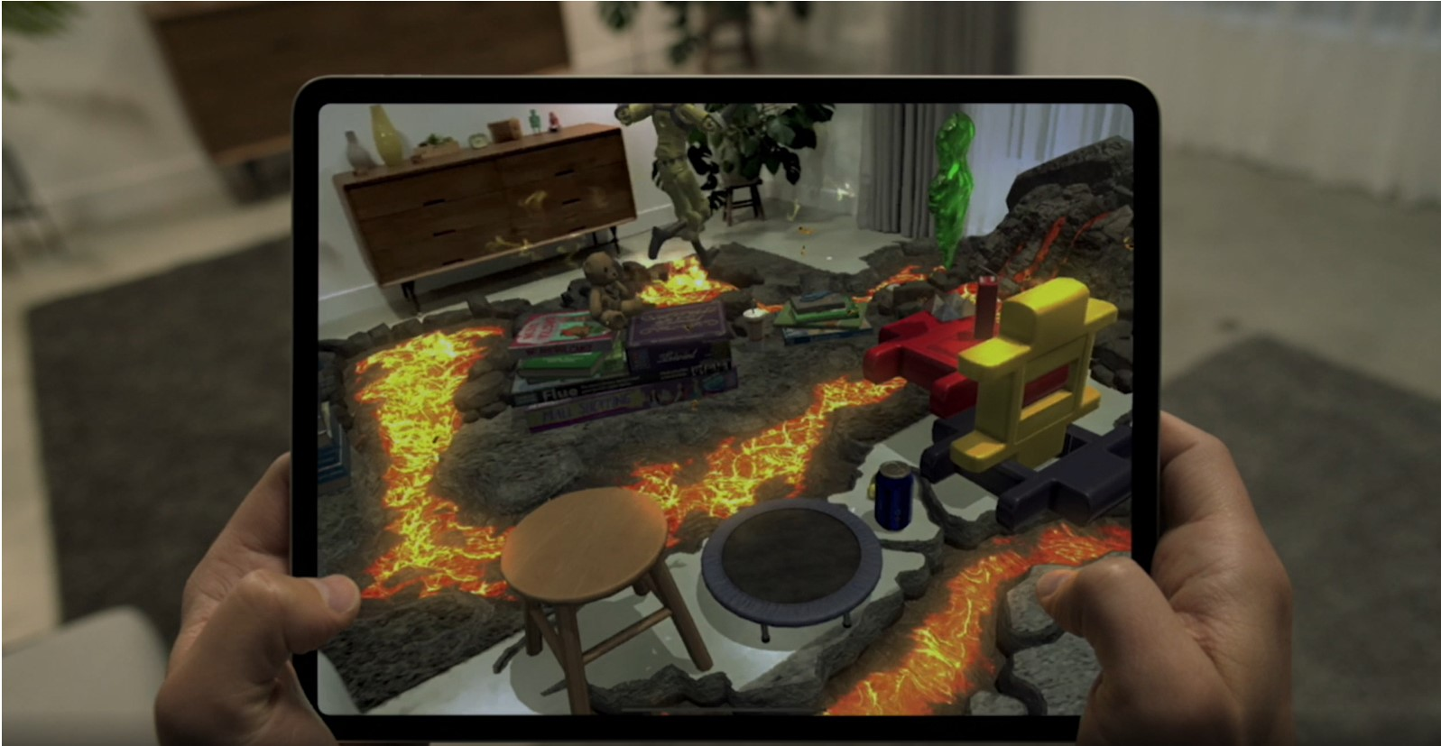
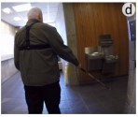
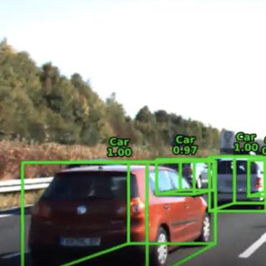
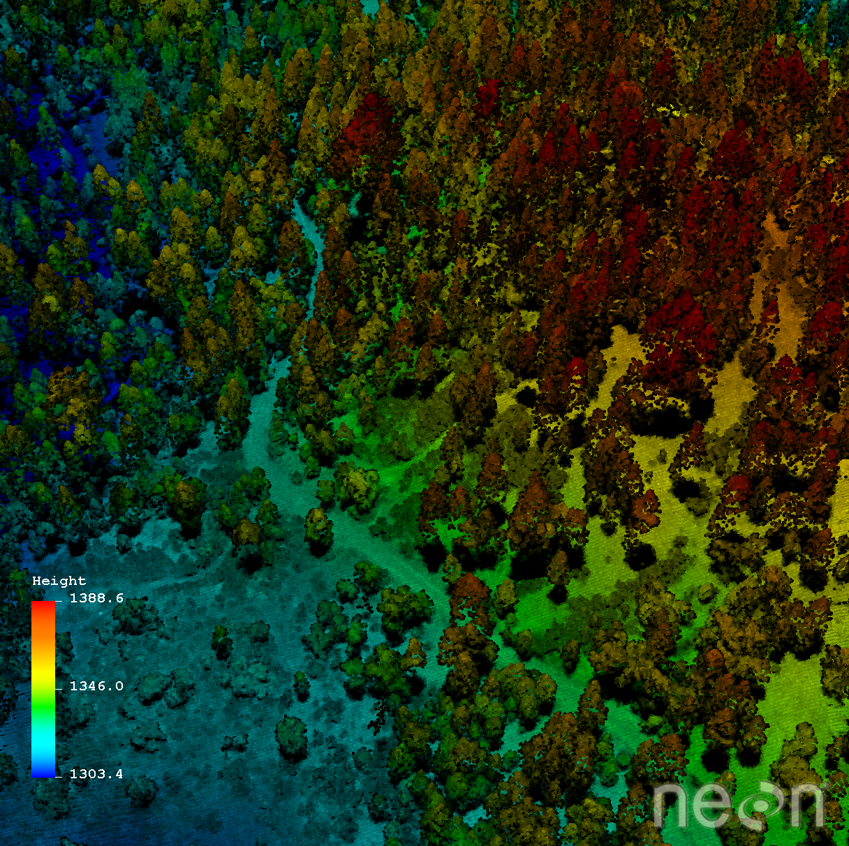
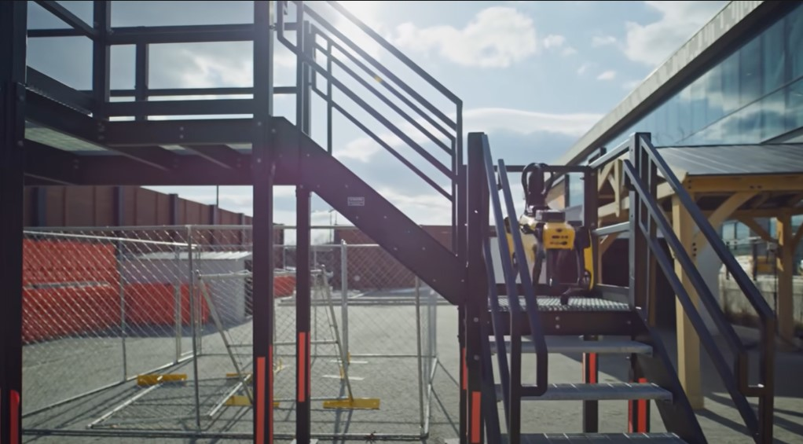
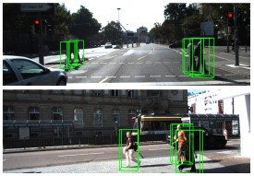
Objective
Source: Apple
Source: Virtual Navigation for Blind People
Source: AVOD
SPOT
Source: VoxelNet
Source: Neon Science
Source: “What’s New in Spot” (YouTube)

Slide 4
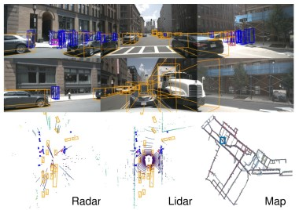
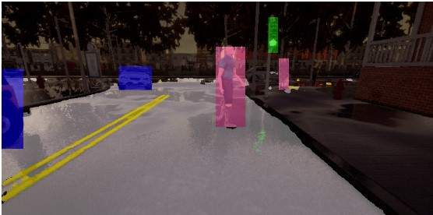
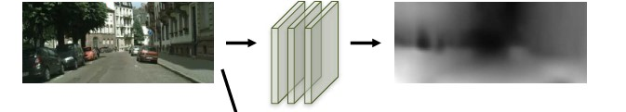
Approaches
Source: nuScenes
Source: Label Efficient Visual Abstractions
Source: Unsupervised Learning of Depth and Ego-Motion

Slide 5
Robotics

Slide 6
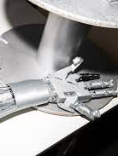
Robotics: Dextrous manipulation
Deep learning techniques over physics driven modeling
“RGB images or depth images as input”
Grasp-pose detection
Creative Commons License
https://commons.wikimedia.org/wiki/File:Robot_hand_-_VivaTech_%2847816344952%29.jpg
Notes:
Grasp pose detection tells a robot how to grasp an object
Modern approaches tend to use convolutional neural networks over standard geometry and physics based analysis techniques

Slide 7
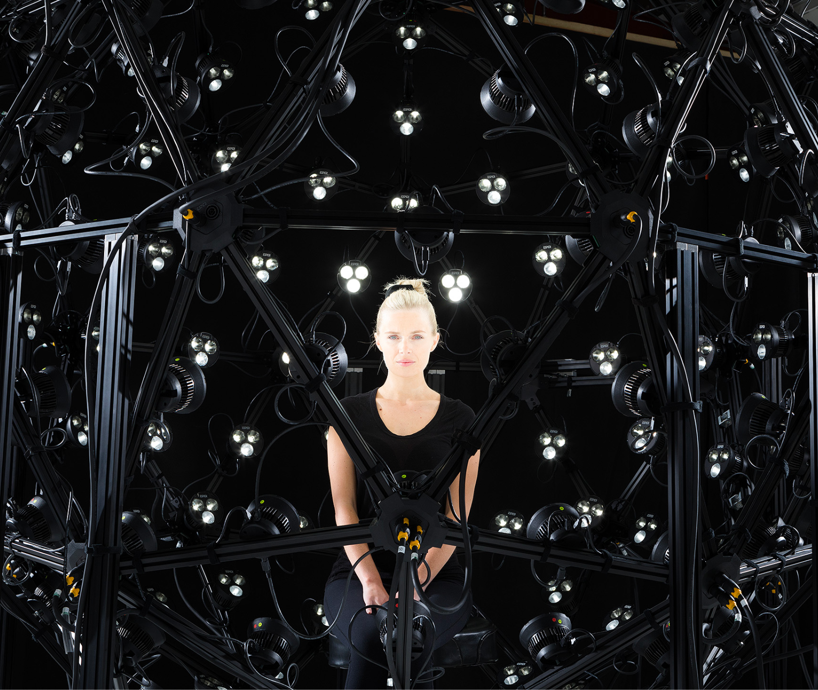
Generating point clouds
Photogrammetry
Lasers
Creative Commons License
https://commons.wikimedia.org/wiki/File:Esper_LightCage_photogrammetry_camera_rig.jpgv
Notes:
This works by first capturing a 3D point cloud of the object and near-object environment
Point clouds can be collected by photogrammetry or with Lasers (like LIDAR)
One is not necessarily better than the other. However with photogrammetry it’s generally harder (more computation, cameras, capture points) to produce super accurate point clouds
Once a point cloud or several are achieved, the learning process begins.

Slide 8
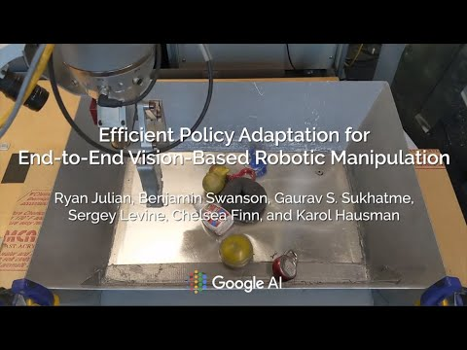
Dextrous learning
Candidate generation
Candidate evaluation
Notes:
Once a point cloud or several are achieved, the learning process begins.
The computer samples various grasp poses (candidate generation) in the point cloud and employ a deep learning method to assess these grasps (candidate evaluation) to obtain the optimal grasp pose
Large area of study. Many companies working on improving this. This problem exists for many types of robots, industrial and in-home.
Everyday robots out of alphabet

Slide 9
AR & Jewelry

Slide 10
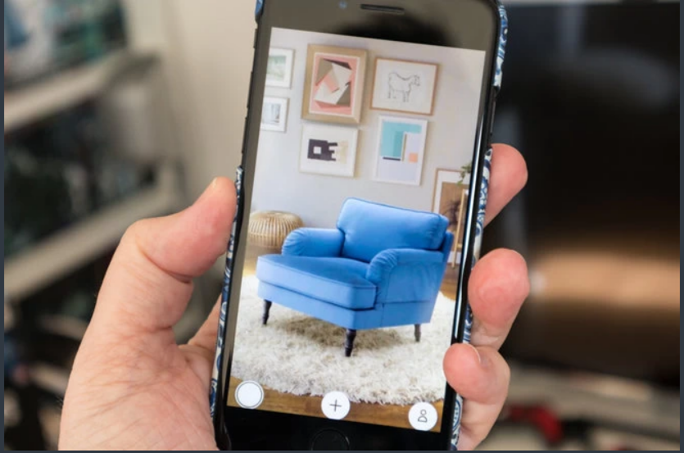
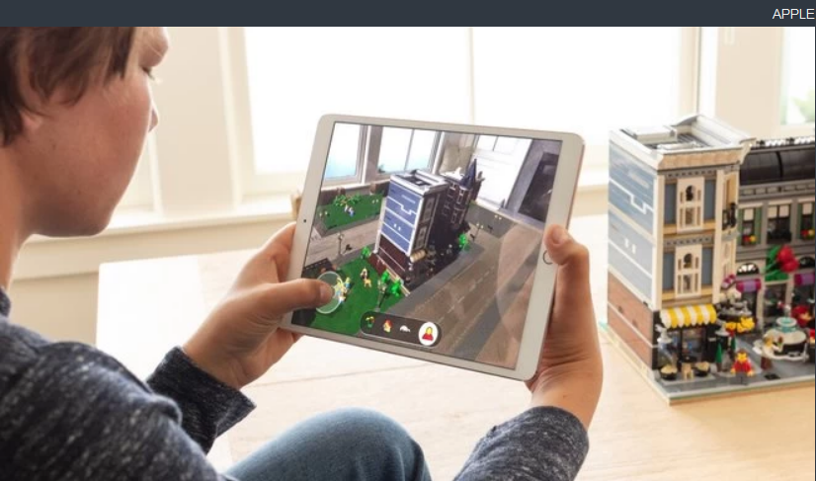
ARKit and its applications
Tool for app developers
Ikea
Tool for app developers
Examples of ARKit:
3D view of Ikea products
Interior decoration project
My thoughts:
Jewelry items
App that checks the authenticity of rings and necklaces, etc.
Notes:
What is ARKit? ARkit stands for Augmented Reality Kit, a development platform that enables app developers to build AR experiences quickly and easily into their apps and games. It utilizes your iOS device's camera, processors, and motion sensors to create some immersive interactions. For example, one could preview Ikea products in his or her own home before making a purchase and look at the product from all the angles needed. With the aid of AR, it is even possible to measure the Ikea furniture dimensions and test the product virtually whether a chair or couch fits in the living room or a bed fits in the bedroom.
In the second example, which is Interior decoration project, multiple users with different devices are able to see the same AR environment. All users can contribute to the Interior decoration project from their own devices.
t’s very hard to tell an original gold or silver ring from a fake one just by looking at the pictures online. Using ARkit and LiDar tools, we propose a new app that determines the properties of the ring by scanning it from different angles. Then it generates the authenticity of the jewelry items.
It would make it easier for both parties, customers, and the jewelry shops to make a safe transaction. It is a win-win situation for both parties: customers are happy with their purchases, while the other party builds a strong reputation for providing high-quality items for sale. Positive feedback + build strong reputation for the brand

Slide 11
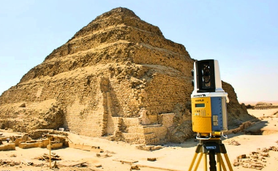
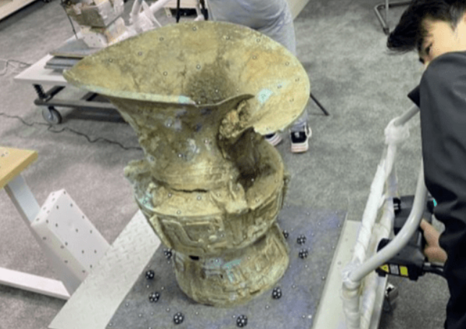
Detection & Archeology
Application:
Ⅰ.Archaeological remains detection
Ⅱ.Surface information extraction of cultural relics
Technology:
Ⅰ.High resolution 3D detector
Ⅱ.Digital image processing
Ⅲ.Visual presentation

Slide 12
Autonomous navigation

Slide 13
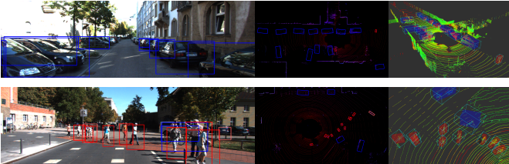
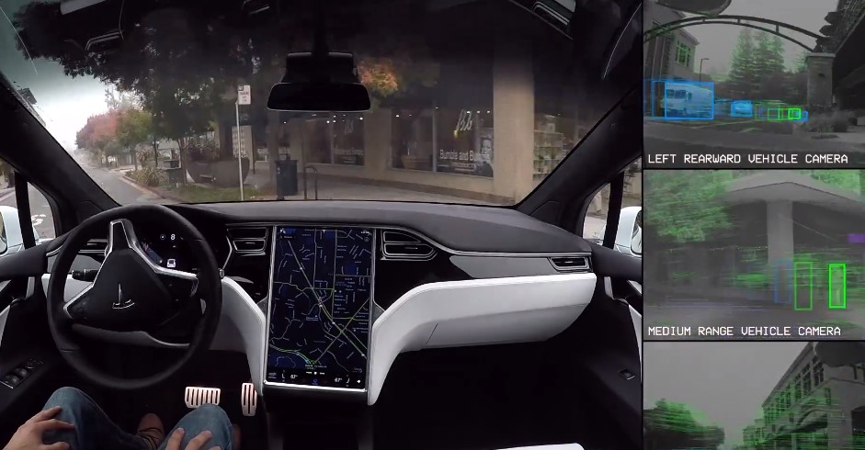
Autonomous Navigation
Source: Tesla
Source: BirdNet
Source: Unsupervised Learning of Depth and Ego-Motion

Slide 14
Sources
Aggregate View Object Detection (AVOD) by Jason Ku, Melissa Mozifian, Jungwook Lee, Ali Harakeh, Steven L. Waslander - Link
VoxelNet: End-to-End Learning for Point Cloud Based 3D Object Detection by Yin Zhou & Oncel Tuzel (Apple) - Link
nuScenes: A multimodal dataset for autonomous driving by Holger Caesar, Varun Bankiti, Alex H. Lang, Sourabh Vora, Venice Erin Liong, Qiang Xu, Anush Krishnan, Yu Pan, Giancarlo Baldan, Oscar Beijbom - Link
“What’s New in Spot | Boston Dynamics” (YouTube)
Neon Science - “The Basics of LiDAR - Light Detection and Ranging - Remote Sensing” by Leah Wasser (Link)
Virtual navigation for blind people: Transferring route knowledge to the real-World by Joao Guerreiro, Daisuke Sato, Dragan Ahmetovic, Eshed Ohn-Bar, Kris M. Kitani - Link
Augmented Reality - Apple (Link)
Unsupervised Learning of Depth and Ego-Motion from Video by Tinghui Zhou, Matthew Brown, Noah Snavely & David Lowe (Link)
Label Efficient Visual Abstractions for Autonomous Driving by Aseem Behl, Kashyap Chitta, Aditya Prakash, Eshed Ohn-Bar, and Andreas Geiger (Link)
BirdNet: a 3D Object Detection Framework from LiDAR Information by Jorge Beltran, Carlos Guindel, Francisco Miguel Moreno, Daniel Cruzado, Fernando Garcia, Arturo de la Escalera (Link)

Slide 15
Sources
https://venturebeat.com/ai/googles-ai-teaches-robots-to-grasp-occluded-objects-and-adapt-to-new-situations/
https://www.frontiersin.org/articles/10.3389/fnbot.2021.658280/full
https://pubmed.ncbi.nlm.nih.gov/34177509/
https://www.dronegenuity.com/point-clouds/
https://www.researchgate.net/publication/298946556_Point_Clouds_Lidar_versus_3D_Vision

Slide 16
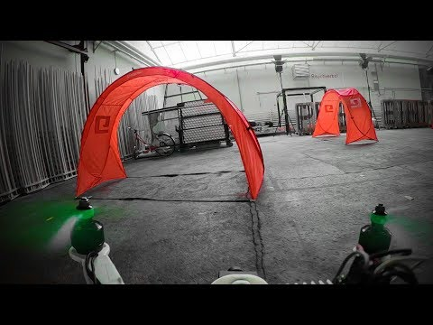
Demo - Drone Racing

